Slide 1
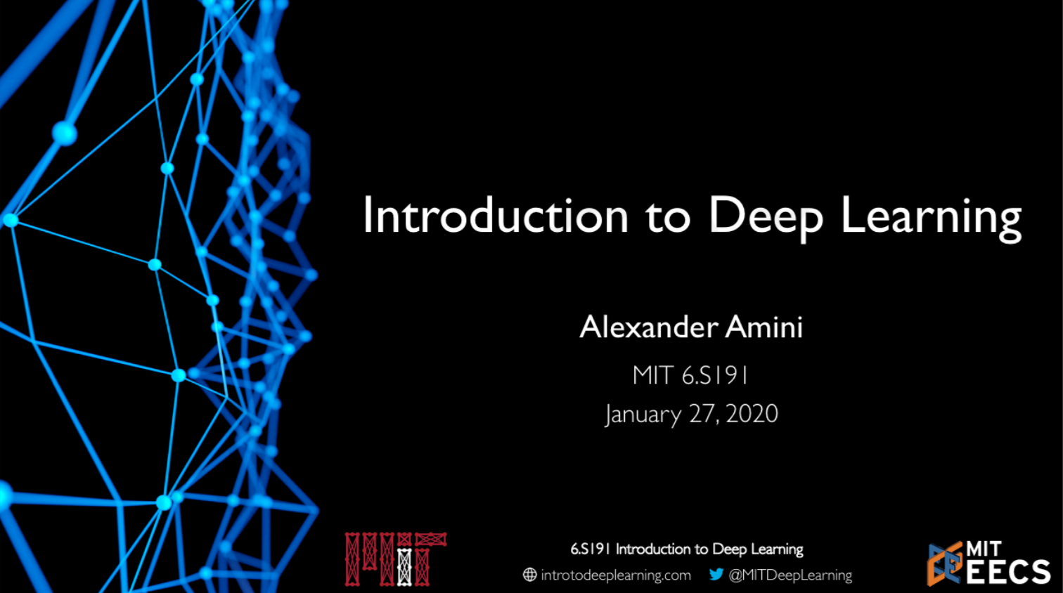

Slide 2

© Alexander Amini and Ava Soleimany MIT 6.S191: Introduction to Deep Learning IntroToDeepLearning.com

Slide 3


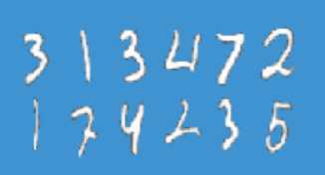
What is Deep Learning??
Artificial Intelligence
Machine Learning
Any technique that enables computers to mimic human behavior
DEEP LEARNING
Ability to learn without explicitly being programmed
Extract patterns form data using neural networks

Slide 4
Why Deep Learning and Why Now?

Slide 5
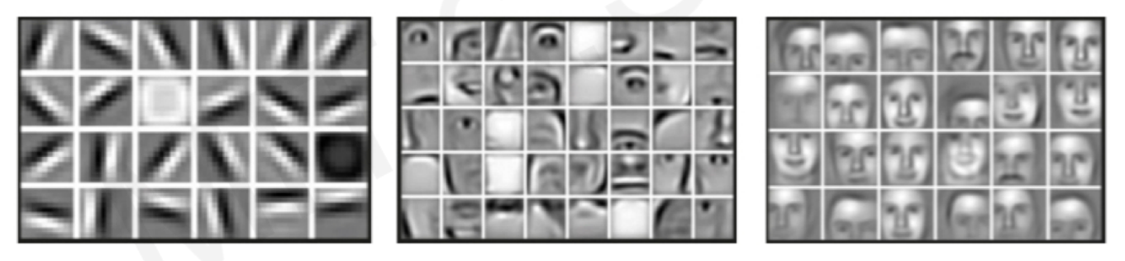
Why Deep Learning?
Hand engineered features are time consuming, brittle, and not scalable in practice
Can we learn the underlying features directly from data?
Mid Level Features
High Level Features
Low Level Features
Lines & Edges
Eyes & Nose & Ears
Facial Structure

Slide 6
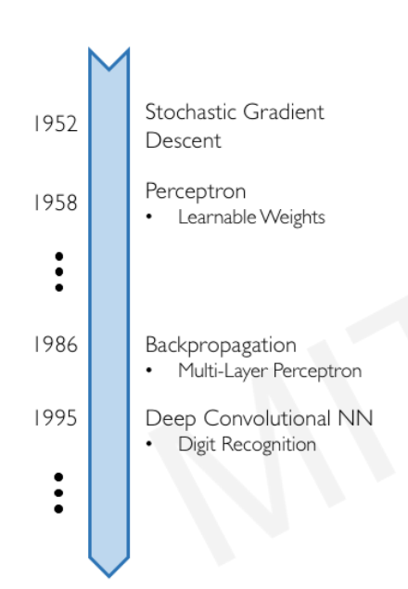

Why Now?
Neural Networks date back decades, so why the resurgence?
Stochastic Gradient Descent
1952
1. Big Data
Larger Datasets
Easier Collection & Storage
2. Hardware
Graphics Processing Units (GPUs)
Massively Parallelizable
3. Software
Improved Techniques
New Models
Toolboxes
Perceptron
Learnable Weights
1958
1986
Backpropagation
Multi-Layer Perceptron
1995
Deep Convolutional NN
Digit Recognition

Slide 7
The Perceptron
The structural building block of deep learning

Slide 8
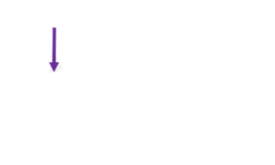
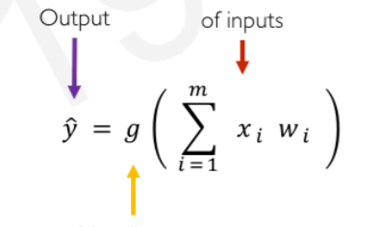
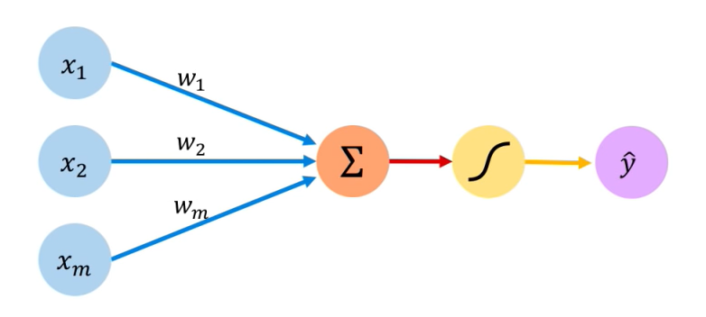
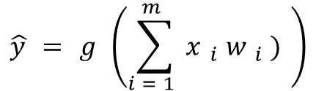
The Perceptron: Forward Propagation
Linear combination of inputs
Output
$$\hat{y}=g\left(\sum_{i=1}^{m}{x_{i}w_{i})}\right)$$
Non-linear activation function
Inputs
Weights
Sum
Non-linearity
Output

Slide 9
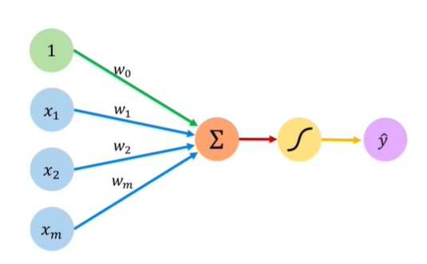
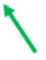
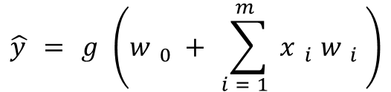
The Perceptron: Forward Propagation
Linear combination of inputs
Output
$$\hat{y}=g\left(w_{0}+\sum_{i=1}^{m}{x_{i}w_{i}}\right)$$
Non-linear activation function
Bias
Inputs
Weights
Sum
Non-linearity
Output

Slide 10
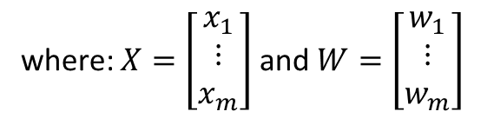
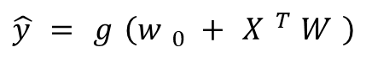
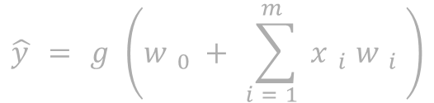
The Perceptron: Forward Propagation
$$\hat{y}=g\left(w_{0}+\sum_{i=1}^{m}{x_{i}w_{i}}\right)$$
$$\hat{y}=g\left(w_{0}+X^{T}W\right)$$
where: $X=\left[\begin{matrix}x_{1} \\ ⋮ \\ x_{m}\end{matrix}\right]$ and $W=\left[\begin{matrix}w_{1} \\ ⋮ \\ w_{m}\end{matrix}\right]$
Inputs
Weights
Sum
Non-linearity
Output

Slide 11
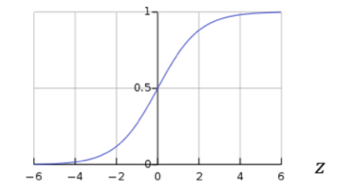
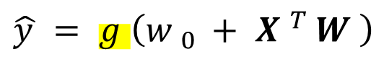
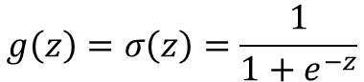
The Perceptron: Forward Propagation
Activation Functions
$$\hat{y}=g\left(w_{0}+X^{T}W\right)$$
Example: sigmoid function
$$g\left(z\right)=σ\left(z\right)=\frac{1}{1+e^{−z}}$$
Inputs
Weights
Sum
Non-linearity
Output

Slide 12
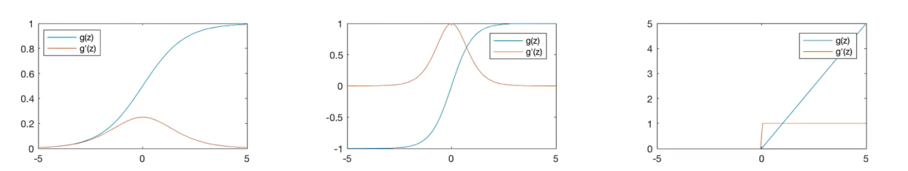

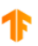
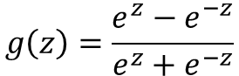
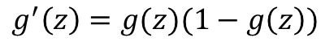
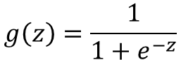
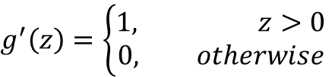
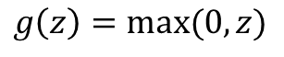
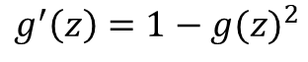
Common Activation Functions
Sigmoid Function
Hyperbolic Tangent
Rectified Linear Unit (ReLU)
$$g\left(z\right)=\frac{1}{1+e^{−z}}$$
$$g\left(z\right)=\frac{e^{z}−e^{−z}}{e^{z}+e^{−z}}$$
$$g\left(z\right)=max⁡(0,z)$$
$$g^{′}\left(z\right)=\left\{\begin{aligned}1, z>0 \\ 0, otherwise\end{aligned}\right.$$
$$g^{′}\left(z\right)=g(z)(1−g\left(z\right))$$
$$g^{′}\left(z\right)=1−g(z)^{2}$$
tf.math.sigmoid(z)
tf.math.tanh(z)
tf.nn.relu(z)
TensorFlow code blocks
NOTE: All activation functions are non-linear

Slide 13
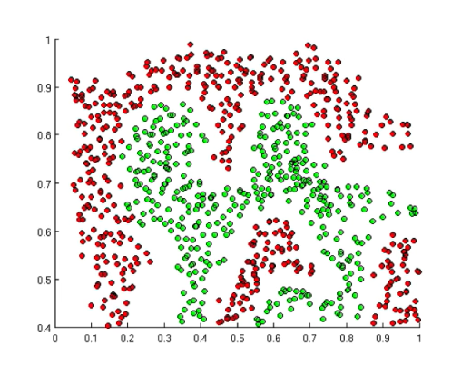
Importance of Activation Functions
The purpose of activation functions is to introduce non-linearities into the network
What if we wanted to build a neural network to distinguish green vs red points?

Slide 14
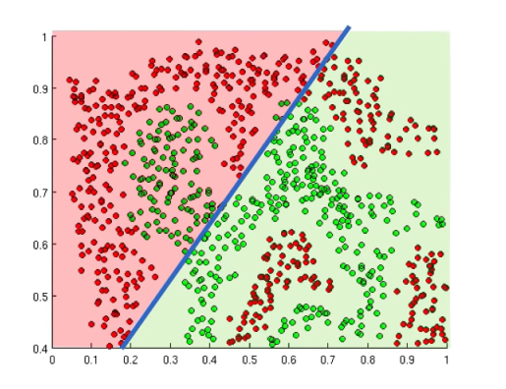
Importance of Activation Functions
The purpose of activation functions is to introduce non-linearities into the network
Linear activation functions produce linear decisions no matter the network size

Slide 15
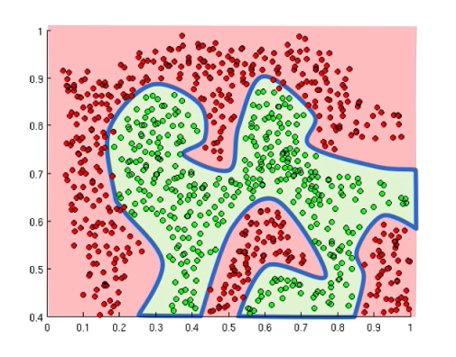
Importance of Activation Functions
The purpose of activation functions is to introduce non-linearities into the network
Linear activation functions produce linear decisions no matter the network size
Non-linearities allow us to approximate arbitrarily complex functions

Slide 16
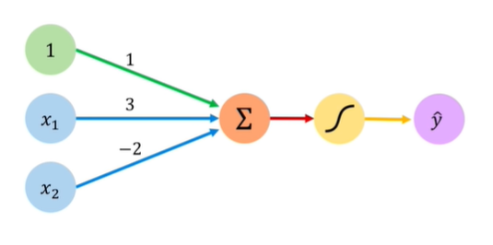

The Perceptron: Example
We have: $w_{0}=1$ and $W=\left[\begin{matrix}3 \\ −2\end{matrix}\right]$

Slide 17
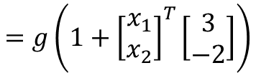
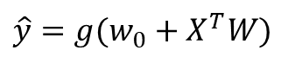
The Perceptron: Example
We have: $w_{0}=1$ and $W=\left[\begin{matrix}3 \\ −2\end{matrix}\right]$
$$\hat{y}=g(w_{0}+X^{T}W)$$
$$=g\left(1+{\left[\begin{matrix}x_{1} \\ x_{2}\end{matrix}\right]}^{T}\left[\begin{matrix}3 \\ −2\end{matrix}\right]\right)$$

Slide 18
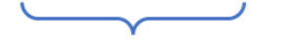
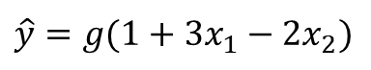
The Perceptron: Example
We have: $w_{0}=1$ and $W=\left[\begin{matrix}3 \\ −2\end{matrix}\right]$
$$\hat{y}=g(w_{0}+X^{T}W)$$
$$=g\left(1+{\left[\begin{matrix}x_{1} \\ x_{2}\end{matrix}\right]}^{T}\left[\begin{matrix}3 \\ −2\end{matrix}\right]\right)$$
$$\hat{y}=g(1+3x_{1}−2x_{2})$$
This is just a line in 2D

Slide 19
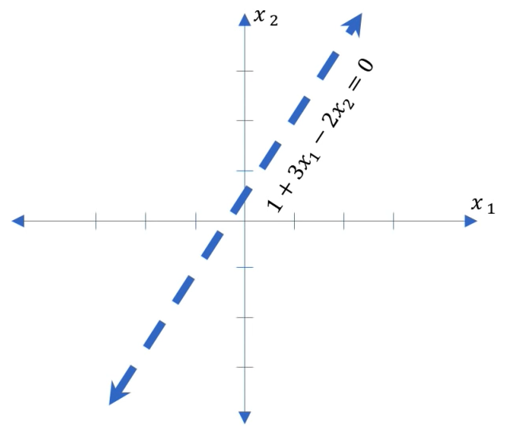
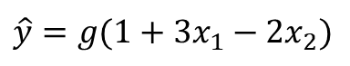
The Perceptron: Example
$$\hat{y}=g(1+3x_{1}−2x_{2})$$

Slide 20
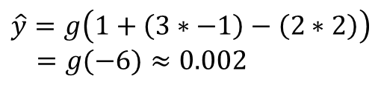
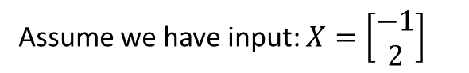
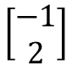
The Perceptron: Example
$$\hat{y}=g(1+3x_{1}−2x_{2})$$
$$\left[\begin{matrix}−1 \\ 2\end{matrix}\right]$$
Assume we have input: $X=\left[\begin{matrix}−1 \\ 2\end{matrix}\right]$
$$\hat{y}=g\left(1+\left(3∗−1\right)−\left(2∗2\right)\right)$$
$=g(−6)≈0.002$

Slide 21
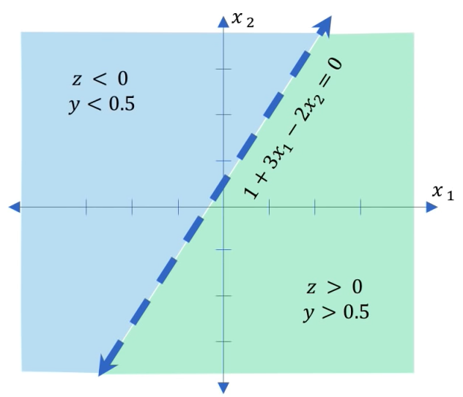
The Perceptron: Example
$$\hat{y}=g(1+3x_{1}−2x_{2})$$

Slide 22
Building Neural Networks with Perceptrons

Slide 23
The Perceptron: Simplified
$$\hat{y}=g(w_{0}+X^{T}W)$$
Inputs
Weights
Sum
Non-linearity
Output

Slide 24
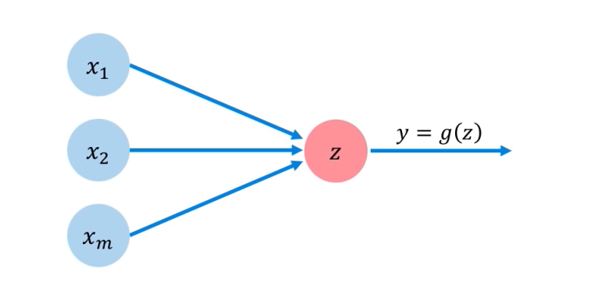
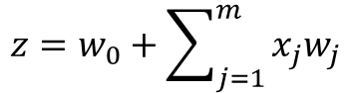
The Perceptron: Simplified
$$z=w_{0}+\sum_{j=1}^{m}{x_{j}w_{j}}$$

Slide 25
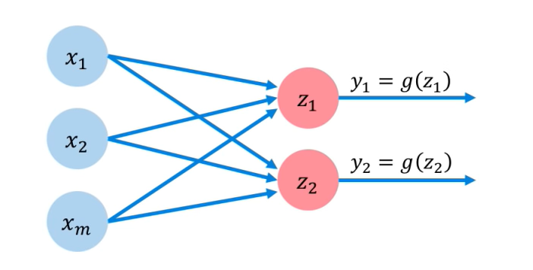
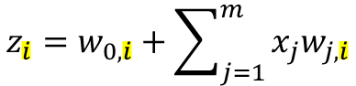
Multi Output Perceptron
Because all inputs are densely connected to all outputs, these layers are called Dense layers
$$z_{i}=w_{0,i}+\sum_{j=1}^{m}{x_{j}w_{j,i}}$$

Slide 26

Dense Layer From Scratch
class MyDenseLayer(tf.keras.layers.Layer):
def __init__(self,input_dim, output_dim):
super(MyDenseLayer, self).__init__()
# Initialize weights and bias
self.W = self.add_weight([input_dim, output_dim])
self.b = self.add_weight([1, output_dim])

Slide 27
Dense Layer From Scratch
class MyDenseLayer(tf.keras.layers.Layer):
def __init__(self,input_dim, output_dim):
super(MyDenseLayer, self).__init__()
# Initialize weights and bias
self.W = self.add_weight([input_dim, output_dim])
self.b = self.add_weight([1, output_dim])
def call(self, inputs):
# Forward propagate the inputs
z = tf.matmul(inputs, self.W + self.b
# Feed through a non-linear activation
output = tf.math.sigmoid(z)
return output

Slide 28
Dense Layer From Scratch
class MyDenseLayer(tf.keras.layers.Layer):
def __init__(self,input_dim, output_dim):
super(MyDenseLayer, self).__init__()
# Initialize weights and bias
self.W = self.add_weight([input_dim, output_dim])
self.b = self.add_weight([1, output_dim])
def call(self, inputs):
# Forward propagate the inputs
z = tf.matmul(inputs, self.W + self.b
# Feed through a non-linear activation
output = tf.math.sigmoid(z)
return output

Slide 29
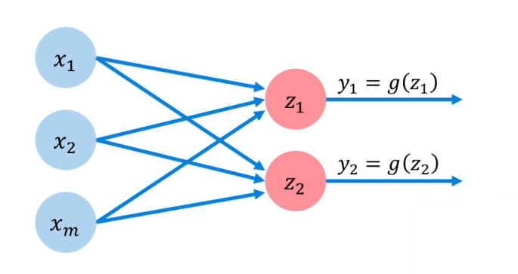
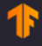
Multi Output Perceptron
Because all inputs are densely connected to all outputs, these layers are called Dense layers
import tensorflow as tf
Layer = tf.keras.layers.Dense(units=2)
$$z_{i}=w_{0,i}+\sum_{j=1}^{m}{x_{j}w_{j,i}}$$

Slide 30
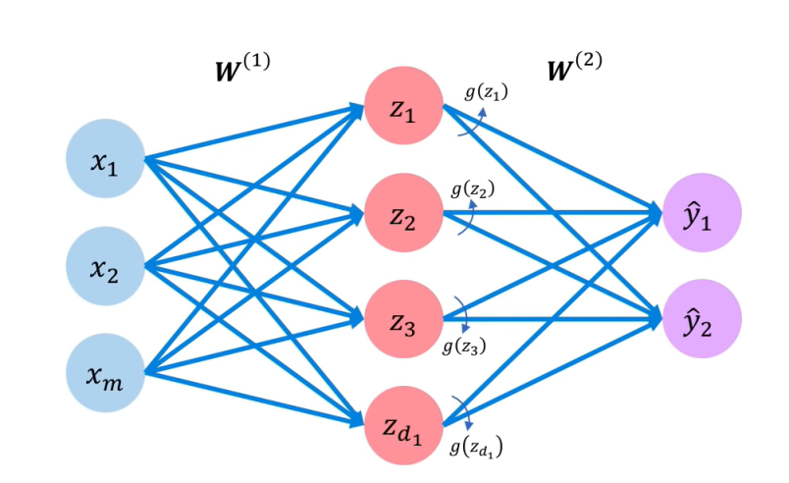
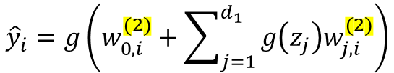
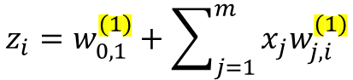
Single Layer Neural Network
Inputs
Hidden
Final Output
$$z_{i}=w_{0,1}^{(1)}+\sum_{j=1}^{m}{x_{j}w_{j,i}^{(1)}}$$
$${\hat{y}}_{i}=g\left(w_{0,i}^{(2)}+\sum_{j=1}^{d_{1}}{g\left(z_{j}\right)w_{j,i}^{(2)}}\right)$$

Slide 31
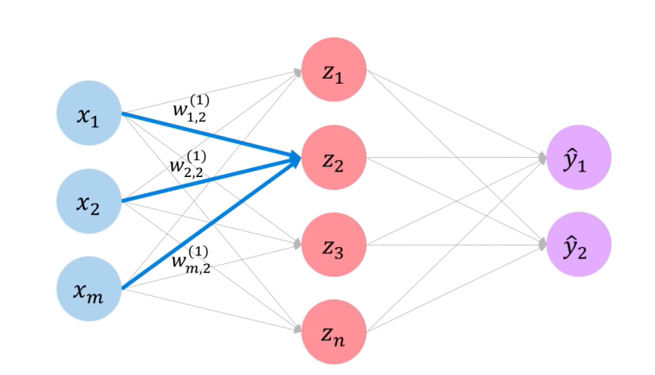
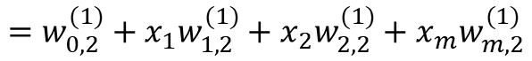

Single Layer Neural Network
$$z_{i}=w_{0,2}^{(1)}+\sum_{j=1}^{m}{x_{j}w_{j,2}^{(1)}}$$
$$=w_{0,2}^{(1)}+x_{1}w_{1,2}^{(1)}+x_{2}w_{2,2}^{(1)}+x_{m}w_{m,2}^{(1)}$$

Slide 32


Multi Output Perceptron
import tensorflow as tf
model = tf.keras.Sequential([
tf.keras.layers.Dense(n),
tf.keras.layers.Dense(2)
])
Inputs
Hidden
Output

Slide 33


Deep Neural Network
Inputs
Hidden
Output
$$z_{k,i}=w_{0,i}^{(k)}+\sum_{j=1}^{n_{k−1}}{g(z_{k−1,j})w_{j,i}^{(k)}}$$

Slide 34



Deep Neural Network
import tensorflow as tf
model = tf.keras.Sequential([
tf.keras.layers.Dense($n_{1}$),
tf.keras.layers.Dense($n_{2}$),
tf.keras.layers.Dense(2)
])
Inputs
Hidden
Output
$$z_{k,i}=w_{0,i}^{(k)}+\sum_{j=1}^{n_{k−1}}{g(z_{k−1,j})w_{j,i}^{(k)}}$$

Slide 35
Applying Neural Networks

Slide 36

Example Problem
Will I pass this class?
Let’s start with a simple two feature model
$x_{1}=$ Number of lectures you attend
$x_{2}=$ Hours spent on the final project

Slide 37


Example Problem: Will I pass this class?
$x_{2}=$ Hours spent on the final project
Legend
Pass
Fail
$x_{1}=$ Number of lectures you attend

Slide 38



Example Problem: Will I pass this class?
$x_{2}=$ Hours spent on the final project
Legend
?
Pass
$$\left[\begin{matrix}4 \\ 5\end{matrix}\right]$$
Fail
$x_{1}=$ Number of lectures you attend

Slide 39


Example Problem: Will I pass this class?
$$x^{(1)}=\left[\begin{matrix}4 & , 5\end{matrix}\right]$$
Predicted: 0.1

Slide 40
Example Problem: Will I pass this class?
$$x^{(1)}=\left[\begin{matrix}4 & , 5\end{matrix}\right]$$
Predicted: 0.1
Actual: 1

Slide 41

Quantifying Loss
The loss of our network measure the cost incurred form incorrect predictions
$$x^{(1)}=\left[\begin{matrix}4 & , 5\end{matrix}\right]$$
Predicted: 0.1
Actual: 1
$$ℒ(f\left(x^{\left(i\right)};W\right),y^{\left(i\right)})$$
Predicted
Actual

Slide 42






Empirical Loss
The empirical loss measures the total loss over our entire dataset
$$f(x)$$
$$y$$
$$X=\left[\begin{matrix}4, & 5 \\ 2, & 1 \\ 5, & 8 \\ ⋮ & ⋮\end{matrix}\right]$$
$$\left[\begin{matrix}0.1 \\ 0.8 \\ 0.6 \\ ⋮\end{matrix}\right]$$
$$\left[\begin{matrix}1 \\ 0 \\ 1 \\ ⋮\end{matrix}\right]$$
$$J\left(W\right)=\frac{1}{n}\sum_{i=1}^{n}{ℒ(f\left(x^{\left(i\right)};W\right),y^{\left(i\right)})}$$
Also known as:
Objective function
Cost function
Empirical Risk
Predicted
Actual

Slide 43
Binary Cross Entropy Loss
Cross entropy loss can be used with models that output a probability between 0 and 1
$$f(x)$$
$$y$$
$$X=\left[\begin{matrix}4, & 5 \\ 2, & 1 \\ 5, & 8 \\ ⋮ & ⋮\end{matrix}\right]$$
$$\left[\begin{matrix}0.1 \\ 0.8 \\ 0.6 \\ ⋮\end{matrix}\right]$$
$$\left[\begin{matrix}1 \\ 0 \\ 1 \\ ⋮\end{matrix}\right]$$
$$J\left(W\right)=\frac{1}{n}\sum_{i=1}^{n}{y^{\left(i\right)}\log\left(f\left(x^{\left(i\right)};W\right)\right)+(1−y^{\left(i\right)})}\log\left(1−f\left(x^{\left(i\right)};W\right)\right)$$
Actual
Predicted
Actual
Predicted
loss = tf.reduce_mean( tf.nn.softmax_cross_entropy_with_logits(y, predicted) )

Slide 44



Mean Squared Error Loss
Mean squared error loss can be used with regression models that output continuous real numbers
$$f(x)$$
$$y$$
$$X=\left[\begin{matrix}4, & 5 \\ 2, & 1 \\ 5, & 8 \\ ⋮ & ⋮\end{matrix}\right]$$
$$\left[\begin{matrix}30 \\ 80 \\ 85 \\ ⋮\end{matrix}\right]$$
$$\left[\begin{matrix}90 \\ 20 \\ 95 \\ ⋮\end{matrix}\right]$$
$$J\left(W\right)=\frac{1}{n}\sum_{i=1}^{n}{{\left(y^{\left(i\right)}−{f\left(x^{\left(i\right)};W\right)}\right)}^{2}}$$
Final Grades
(Percentage)
Actual
Predicted
loss = tf.reduce_mean( tf.square( tf.subtract (y, predicted) ) )

Slide 45
Training Neural Networks

Slide 46




Loss Optimization
We want to find the network weights that achieve the lowest loss
$W$* $=$ argmin$\frac{1}{n}\sum_{i=1}^{n}{ℒ\left(f\left(x^{\left(i\right)};W\right),y^{(i)}\right)}$
$$W$$
$W$* $=$ argmin $J(W)$
$$W$$

Slide 47


Loss Optimization
We want to find the network weights that achieve the lowest loss
$W$* $=$ argmin$\frac{1}{n}\sum_{i=1}^{n}{ℒ\left(f\left(x^{\left(i\right)};W\right),y^{(i)}\right)}$
$$W$$
$W$* $=$ argmin $J(W)$
$$W$$
Remember:
$$W=\{W^{\left(0\right)},W^{\left(1\right)},…\}$$

Slide 48





Loss Optimization
$W$* $=$ argmin $J(W)$
$$W$$
Remember: Our loss is a function of the network weights
$$J(w_{0},w_{1})$$
$$w_{1}$$
$$w_{0}$$

Slide 49

Loss Optimization
Randomly pick an initial $(w_{0},w_{1})$
$$J(w_{0},w_{1})$$
$$w_{1}$$
$$w_{0}$$

Slide 50

Loss Optimization
C$ompute gradient, \frac{∂J(W)}{∂W}$
$$J(w_{0},w_{1})$$
$$w_{1}$$
$$w_{0}$$

Slide 51
Loss Optimization
Take small step in opposite direction of gradient
$$J(w_{0},w_{1})$$
$$w_{1}$$
$$w_{0}$$

Slide 52
Loss Optimization
Repeat until convergence
$$J(w_{0},w_{1})$$
$$w_{1}$$
$$w_{0}$$

Slide 53

Gradient Descent
Algorithm
Initialize weights randomly $\sim N(0,σ^{2}$)
Loop until convergence:
Compute gradient, $\frac{∂J(W)}{∂W}$
Update weights, $W←W−η\frac{∂J(W)}{∂W}$
Return weights

Slide 54



Gradient Descent
import tensorflow as tf
weights = tf.Variable([tf.random.normal()])
while True: # loop forever
with tf.GradientTape() as g:
loss = compute_loss(weights)
gradient = g.gradient(loss, weights)
weights = weights – lr * gradient
Algorithm
Initialize weights randomly $\sim N(0,σ^{2}$)
Loop until convergence:
Compute gradient, $\frac{∂J(W)}{∂W}$
Update weights, $W←W−η\frac{∂J(W)}{∂W}$
Return weights

Slide 55
Gradient Descent
import tensorflow as tf
weights = tf.Variable([tf.random.normal()])
while True: # loop forever
with tf.GradientTape() as g:
loss = compute_loss(weights)
gradient = g.gradient(loss, weights)
weights = weights – lr * gradient
Algorithm
Initialize weights randomly $\sim N(0,σ^{2}$)
Loop until convergence:
Compute gradient, $\frac{∂J(W)}{∂W}$
Update weights, $W←W−η\frac{∂J(W)}{∂W}$
Return weights

Slide 56


Computing Gradients: Backpropagation
How does a small change in one weight (ex. $w_{2}$) affect the final loss J(W)?

Slide 57


Computing Gradients: Backpropagation
$$\frac{∂J(W)}{∂w_{2}} =$$
Let’s use the chain rule

Slide 58



Computing Gradients: Backpropagation
$$\frac{∂J(W)}{∂w_{2}} =\frac{∂J(W)}{∂\hat{y}}∗\frac{∂\hat{y}}{∂w_{2}}$$

Slide 59



Computing Gradients: Backpropagation
$$\frac{∂J(W)}{∂w_{1}} =\frac{∂J(W)}{∂\hat{y}}∗\frac{∂\hat{y}}{∂w_{1}}$$
Apply chain rule
Apply chain rule

Slide 60



Computing Gradients: Backpropagation
$$\frac{∂J(W)}{∂w_{1}} =\frac{∂J(W)}{∂\hat{y}}∗\frac{∂\hat{y}}{∂w_{1}}∗\frac{∂z_{1}}{∂w_{1}}$$

Slide 61
Computing Gradients: Backpropagation
$$\frac{∂J(W)}{∂w_{1}} =\frac{∂J(W)}{∂\hat{y}}∗\frac{∂\hat{y}}{∂w_{1}}∗\frac{∂z_{1}}{∂w_{1}}$$
Repeat this for every weight in the network using gradients from later layers

Slide 62
Neural Networks in Practice Optimization

Slide 63

Training Neural Networks is Difficult
“Visualizing the loss landscape of neural nets” . Dec 2017.

Slide 64

Loss Functions Can Be Difficult to Optimize
Remember:
Optimization through gradient decent
$$W←W−η\frac{∂J(W)}{∂W}$$

Slide 65

Loss Functions Can Be Difficult to Optimize
Remember:
Optimization through gradient decent
$$W←W−η\frac{∂J(W)}{∂W}$$
How can we set the learning rate?

Slide 66



Setting the Learning Rate
Small learning rate converges slowly and gets stuck in false local minima
$$J(W)$$
Initial guess
$$w$$

Slide 67
Setting the Learning Rate
Large learning rates overshoot, become unstable and diverge
$$J(W)$$
Initial guess
$$w$$

Slide 68
Setting the Learning Rate
stable learning rates converge smoothly and avoid local minima
$$J(W)$$
Initial guess
$$w$$

Slide 69
How to deal with this?
Idea 1:
try lots of different learning rates and see what works “just right”

Slide 70
How to deal with this?
Idea 1:
try lots of different learning rates and see what works “just right”
Idea 2:
Do something smarter!
Design an adaptive learning rate that “adapts” to the landscape

Slide 71
Adaptive Learning Rates
Learning rates are no longer fixed
Can be made larger or smaller depending on:
How large gradient is
How fast learning is happening
Size of particular weights
Etc…

Slide 72
Gradient Descent Algorithms
Algorithm
SGD
Adam
Adadelta
Adagrad
RMSProp
TF Implementation
Reference
Kiefer & Wolfowitz. “Stochastic Estimation of the Maximum of a Regression Function.” 1952.
Kingma et al. “Adam: A Method for Stochastic Optimization.” 2014.
Zeiler et al. “ADADELTA: An Adaptive Learning Rate Method.” 2012
Duchi et al. “Adaptive Subgradient Methods for Online Learning and Stochastic Optimization.” 2011.
tf.keras.optimizers.SGD
tf.keras.optimizers.Adam
tf.keras.optimizers.Adadelta
tf.keras.optimizers.Adagrad
tf.keras.optimizers.RMSProp
Additional details: http://ruder.io/optimizing-gradient-descent/

Slide 73


Putting it all together
import tensorflow as tf
model = tf.keras.Sequential([…])
# pick your favorite optimizer
optimizer = tf.keras.optimizer.SGD()
while True: # loop forever
# forward pass through the network
prediction = model(x)
with tf.GradientTape() as tape:
# compute the loss
loss = compute_loss(y, prediction)
# update the weights using the gradient
grads = tape.gradient(loss, model.trainable_variables)
optimizer.apply_gradients(zip(grads, model.trainable_variables))

Slide 74
Neural Networks in Practice: Mini-batches

Slide 75


Gradient Descent
Algorithm
Initialize weights randomly $\sim N(0,σ^{2})$
Loop until convergence
Compute gradient, $\frac{∂J(W)}{∂W}$
Update weights, $W ← W−η$ $\frac{∂J(W)}{∂W}$
Return weights

Slide 76

Gradient Descent
Algorithm
Initialize weights randomly $\sim N(0,σ^{2})$
Loop until convergence
Compute gradient, $\frac{∂J(W)}{∂W}$
Update weights, $W ← W−η$ $\frac{∂J(W)}{∂W}$
Return weights
Can be very computationally intensive to compute

Slide 77

Stochastic Gradient Descent
Algorithm
Initialize weights randomly $\sim N(0,σ^{2})$
Loop until convergence
Pick single data point $i$
Compute gradient, $\frac{∂J(W)}{∂W}$
Update weights, $W ← W−η$ $\frac{∂J(W)}{∂W}$
Return weights

Slide 78
Stochastic Gradient Descent
Algorithm
Initialize weights randomly $\sim N(0,σ^{2})$
Loop until convergence
Pick single data point $i$
Compute gradient, $\frac{∂J(W)}{∂W}$
Update weights, $W ← W−η$ $\frac{∂J(W)}{∂W}$
Return weights
Easy to compute but very noisy (stochastic)

Slide 79

Stochastic Gradient Descent
Algorithm
Initialize weights randomly $\sim N(0,σ^{2})$
Loop until convergence
Pick batch of B data points
Compute gradient, $\frac{∂J(W)}{∂W}=\frac{1}{B}\sum_{k=1}^{B}{\frac{∂J_{k}(W)}{∂W}}$
Update weights, $W ← W−η$ $\frac{∂J(W)}{∂W}$
Return weights

Slide 80
Stochastic Gradient Descent
Algorithm
Initialize weights randomly $\sim N(0,σ^{2})$
Loop until convergence
Pick batch of B data points
Compute gradient, $\frac{∂J(W)}{∂W}=\frac{1}{B}\sum_{k=1}^{B}{\frac{∂J_{k}(W)}{∂W}}$
Update weights, $W ← W−η$ $\frac{∂J(W)}{∂W}$
Return weights
Fast to compute and a much better estimate of the true gradient

Slide 81
Mini-batches while training
More accurate estimation of gradient
Smoother convergence
Allows for larger learning rates

Slide 82
Mini-batches while training
More accurate estimation of gradient
Smoother convergence
Allows for larger learning rates
Mini-batches lead to fast training
Can parallelize computation + achieve significant speed increases on GPU’s

Slide 83
Neural Networks in Practice: Overfitting

Slide 84

The Problem of Overfitting
Underfitting
Model does not have capacity to fully learn the data
Ideal fit
Overfitting
Too complex, extra parameters, does not generalize well

Slide 85
Regularization
What is it?
Technique that constrains our optimization problem to discourage complex models

Slide 86
Regularization
What is it?
Technique that constrains our optimization problem to discourage complex models
Why do we need it?
Improve generalization of our model on unseen data

Slide 87

Regularization 1: Dropout
During training, randomly set some activations to 0
© Alexander Amini and Ava Soleimany MIT 6.S191: Introduction to Deep Learning IntroToDeepLearning.com

Slide 88

Regularization 1: Dropout
During training, randomly set some activations to 0
Typically ‘drop’ 50% of activations in layer
Forces network to not rely on any 1 node
tf.keras.layers.Dropout (p=0.5)
© Alexander Amini and Ava Soleimany MIT 6.S191: Introduction to Deep Learning IntroToDeepLearning.com

Slide 89

Regularization 1: Dropout
During training, randomly set some activations to 0
Typically ‘drop’ 50% of activations in layer
Forces network to not rely on any 1 node
tf.keras.layers.Dropout (p=0.5)

Slide 90

Regularization 2: Early Stopping
Stop training before we have a chance to overfit
Loss
Training Iterations

Slide 91

Regularization 2: Early Stopping
Stop training before we have a chance to overfit
Legend
Loss
Testing
Training
Training Iterations

Slide 92

Regularization 2: Early Stopping
Stop training before we have a chance to overfit
Legend
Loss
Testing
Training
Training Iterations

Slide 93

Regularization 2: Early Stopping
Stop training before we have a chance to overfit
Legend
Loss
Testing
Training
Training Iterations

Slide 94

Regularization 2: Early Stopping
Stop training before we have a chance to overfit
Legend
Loss
Testing
Training
Training Iterations

Slide 95

Regularization 2: Early Stopping
Stop training before we have a chance to overfit
Legend
Loss
Testing
Training
Training Iterations

Slide 96

Regularization 2: Early Stopping
Stop training before we have a chance to overfit
Legend
Stop training here
Loss
Testing
Training
Training Iterations

Slide 97

Regularization 2: Early Stopping
Stop training before we have a chance to overfit
Under-fitting
Over-fitting
Legend
Stop training here
Loss
Testing
Training
Training Iterations

Slide 98



Core Foundation Review
The Perceptron
Neural Networks
Training in Practice
Structural building blocks
Nonlinear activation functions
Stacking Perceptrons to form neural networks
Optimization through backpropagation
Adaptive learning
Batching
Regularization

